Slide 1
Network Layer: IP Addressesing GitHub - AhmadNawaz110/CE313-Computer-Commincation-and-Network-Spring-2026-
CE313
Computer Communication & Networks
Engr. M Ahmad Nawaz
Engr.ahmad.nawaz@giki.edu.pk
Notes:
As we know, most of the applications like HTTP, FTP requires reliability. Furthermore, we know that TCP provides reliability Service. Before going in to the detail how TCP reliability mechanism works. Lets built a reliable data transfer protocol step by step in order to understand the underlying challenges, which are addressed by TCP.

Slide 2
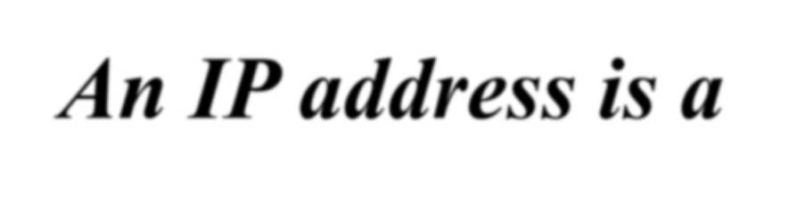
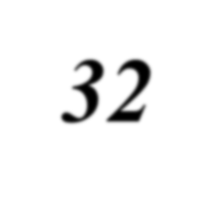
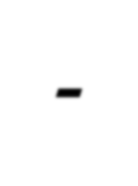
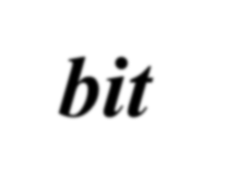
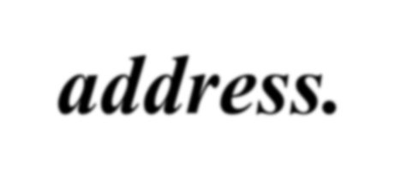

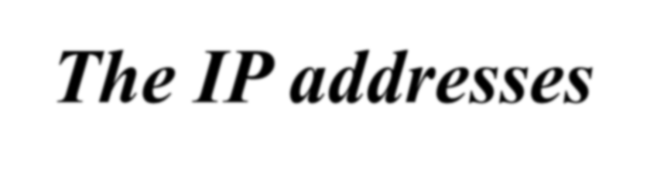
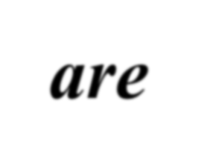
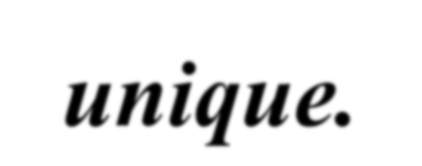
What is an IPV4 Address?

Slide 3
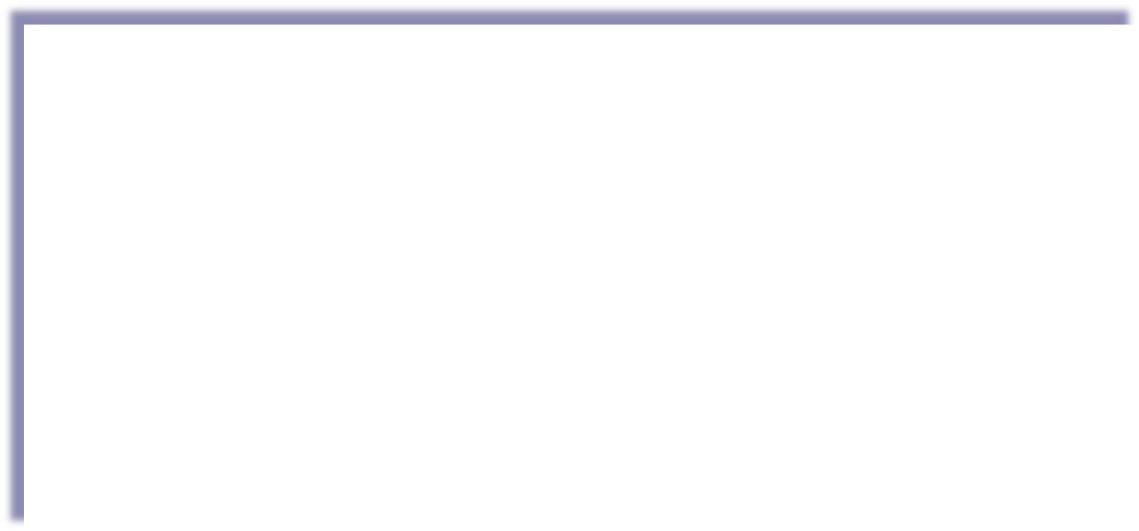
Address Space
…………..
…………..
addr1
addr15
addr2
…………..
…………..
…………..
addr41
addr226
addr31
…………..
…………..

Slide 4

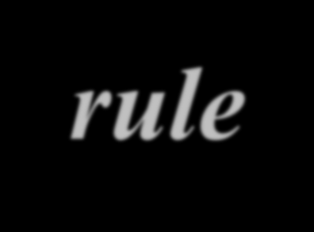
Address space rule
…………..
…………..
The address space in a protocol That uses N-bits to define an Address is:
₂N

Slide 5

IPv4 address space
The address space of IPv4 is ₂32
or 4,294,967,296.
Notes:
₂32
or 4,294,967,296

Slide 6
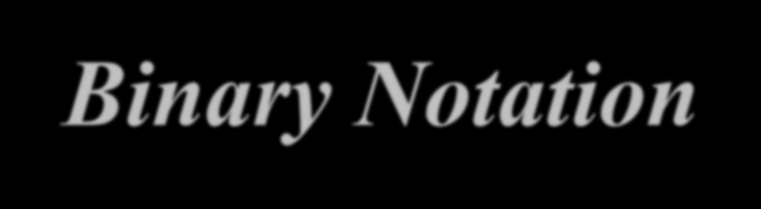
Binary Notation
01110101 10010101 00011101 11101010

Slide 7
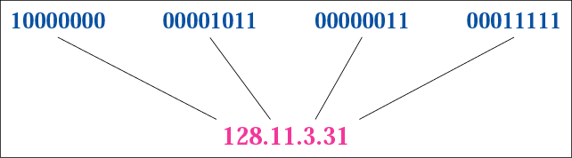
Dotted-decimal notation

Slide 8
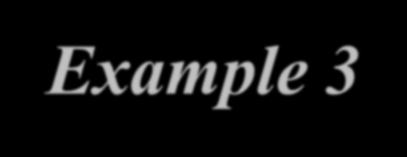
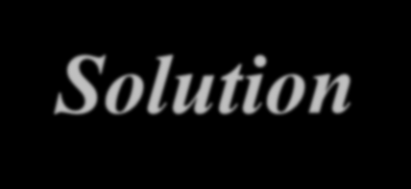
Example 3
Find the error in the following IP Address 111.56.045.78
Solution
There are no leading zeroes in Dotted-decimal notation (045)

Slide 9
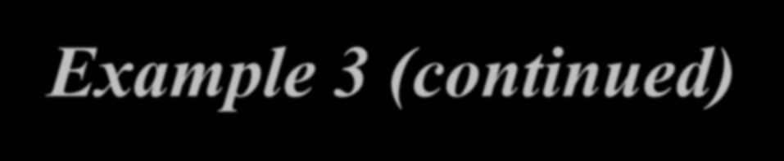

Example 3 (continued)
Find the error in the following IP Address 75.45.301.14
Solution
In decimal notation each number <= 255 301 is out of the range

Slide 10
CLASSFUL ADDRESSING

Slide 11

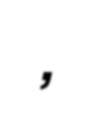

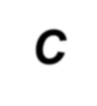


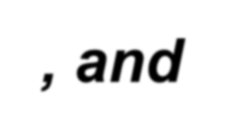

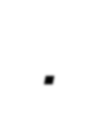
In classful addressing the address space is divided into 5 classes:
A, B, C, D, and E.

Slide 12
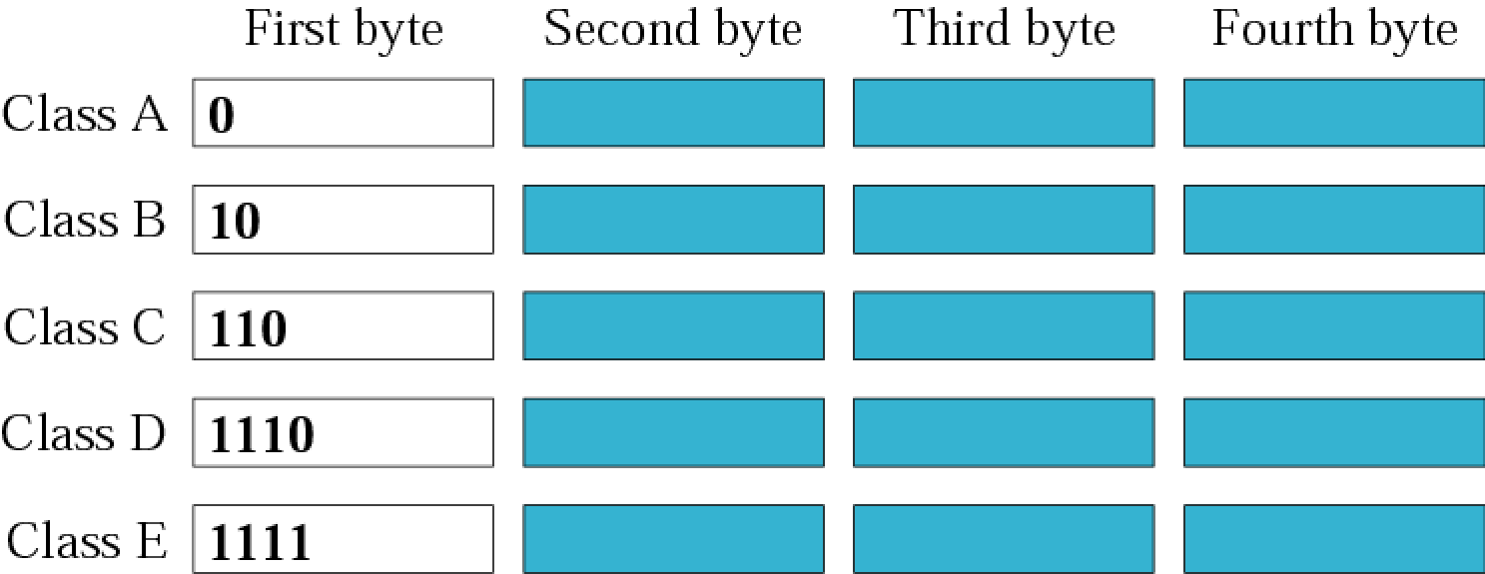
Finding the class in binary notation

Slide 13
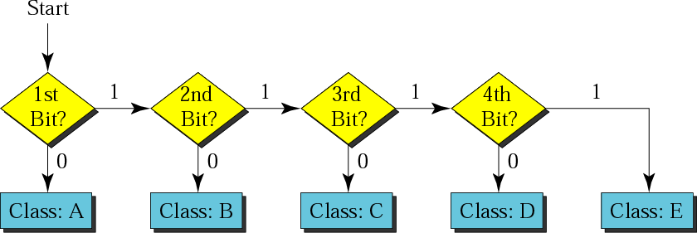
Finding the address class

Slide 14
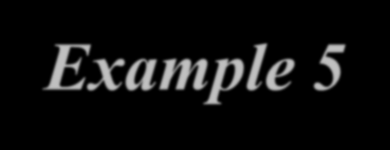
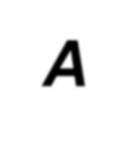
Example 5
Show that Class A has
2³¹ = 2,147,483,648 addresses:
In class A, only 1 bit defines the class. The remaining 31 bits are available for the address. With 31 bits, we can have 2^31 or 2,147,483,648 addresses.

Slide 15
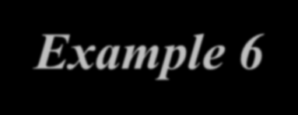
Example 6
Find the class of the following IP addresses
00000001 | 00001011 | 00001011 11101111
11000001 | 00001011 | 00001011 11101111
Solution
00000001 00001011 00001011 11101111
1st is 0, hence it is Class A
11000001 00001011 00001011 11101111
1st and 2nd bits are 1, and 3rd bit is 0 hence, Class C

Slide 16
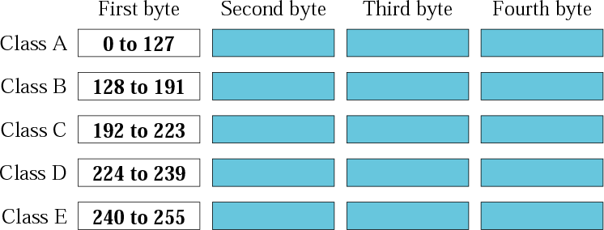
Finding the class in decimal notation

Slide 17
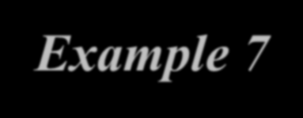
Example 7
Find the class of the following addresses 158.223.1.108
227.13.14.88
Solution
158.223.1.108
1st byte = 158 (128<158<191) class B
227.13.14.88
1st byte = 227 (224<227<239) class D

Slide 18
IP address with appending port number
158.128.1.108:25
the four octet before colon is the IP address
The number after colon (25) is the port number

Slide 19
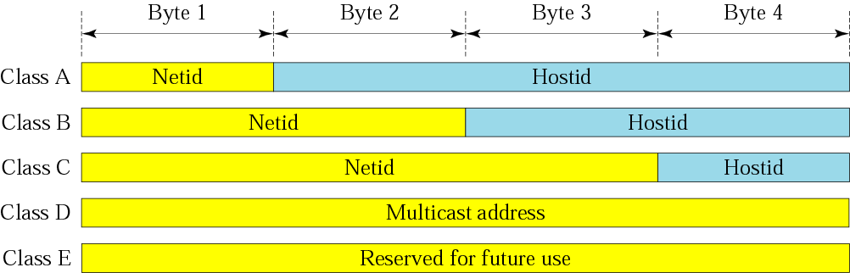
Netid and hostid

Slide 20
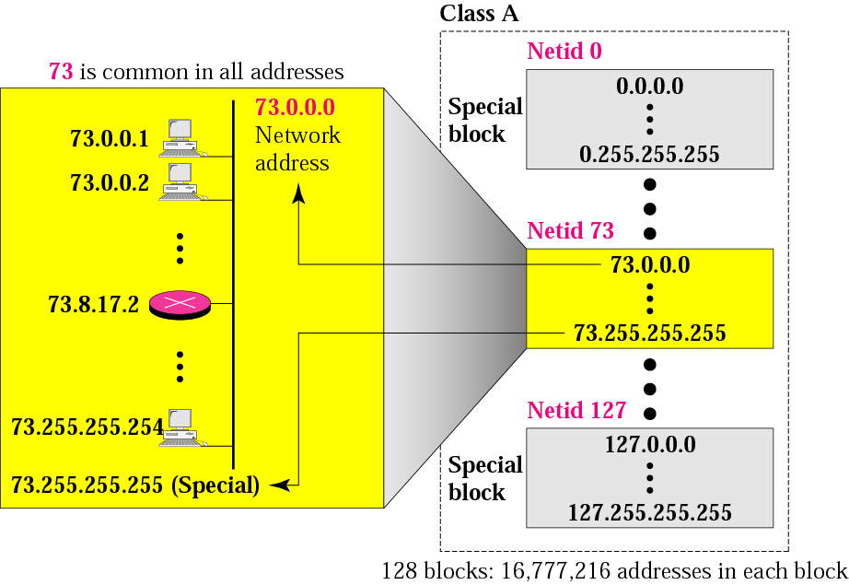
Blocks in class A

Slide 21
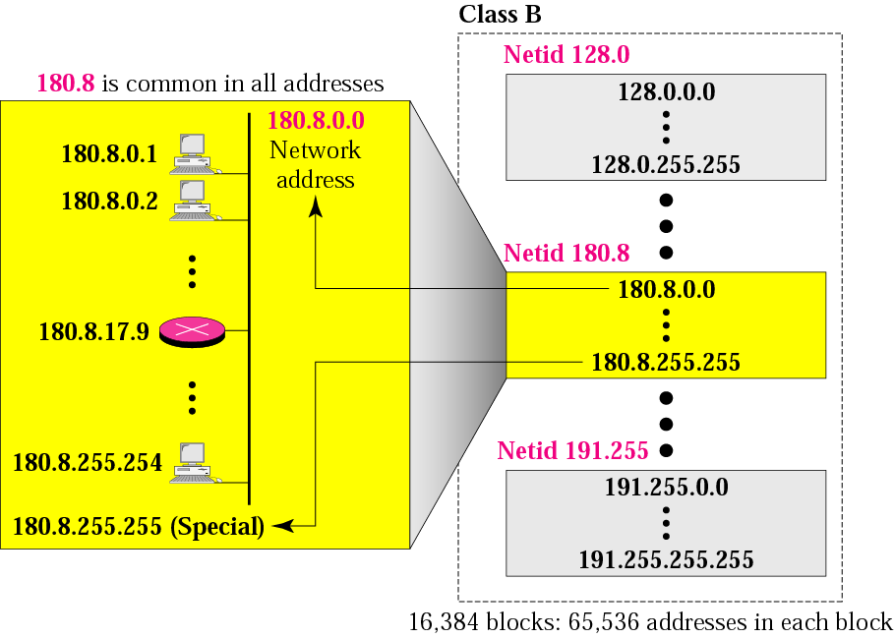
Blocks in class B

Slide 22
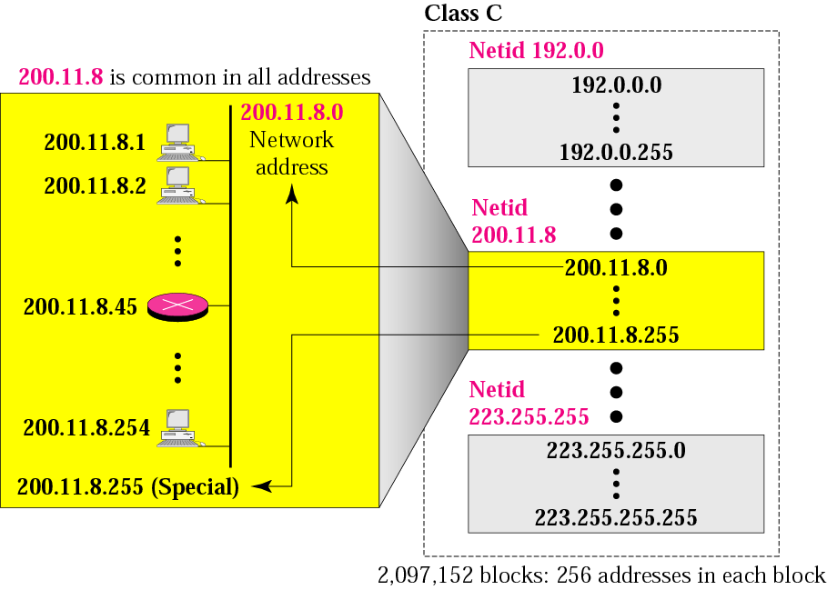
Blocks in class C

Slide 23

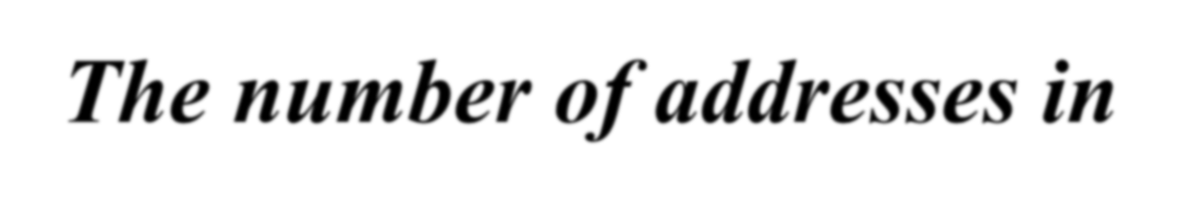

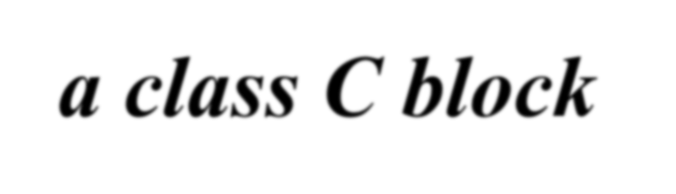
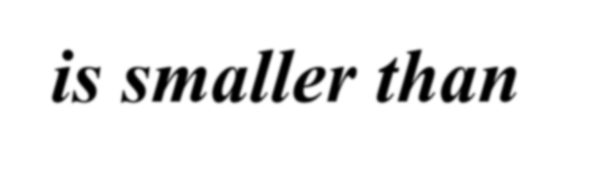
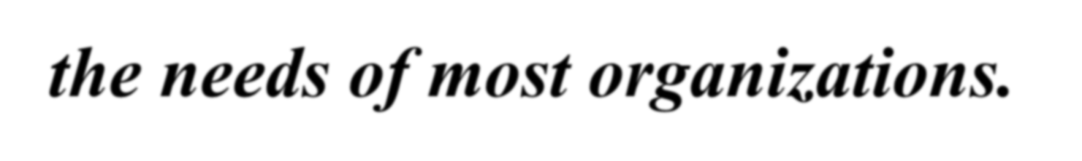

Slide 24
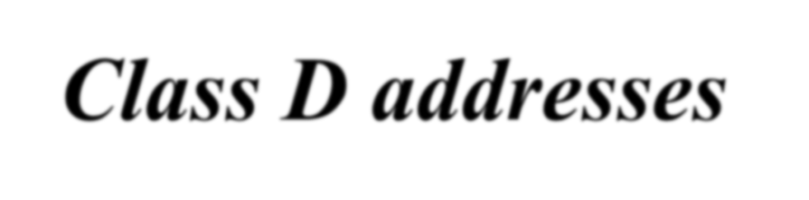

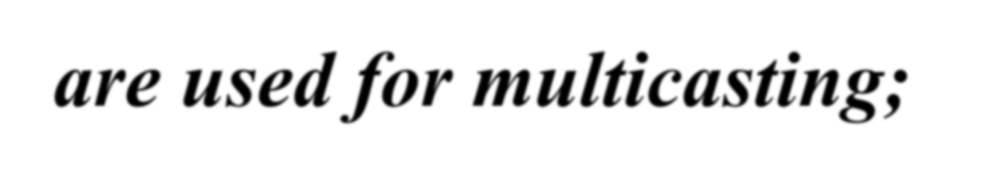
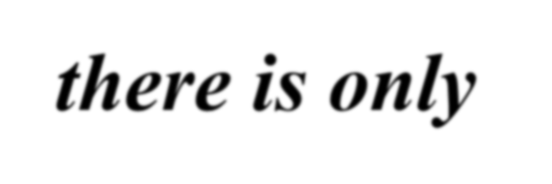
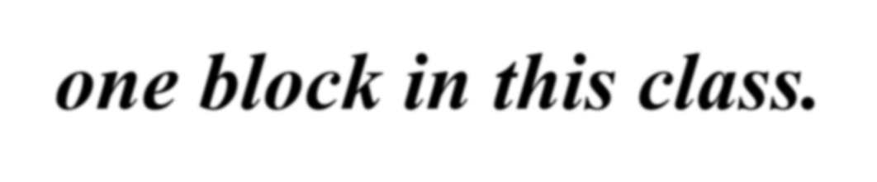

Slide 25
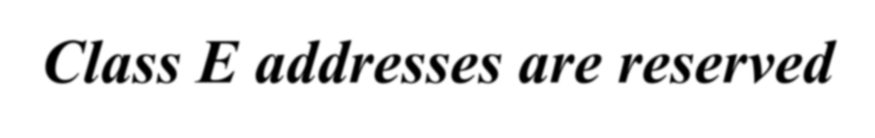

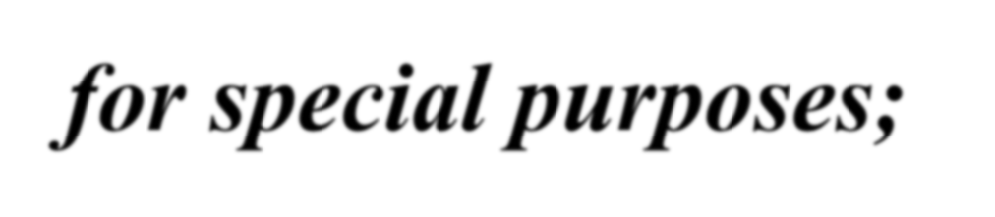
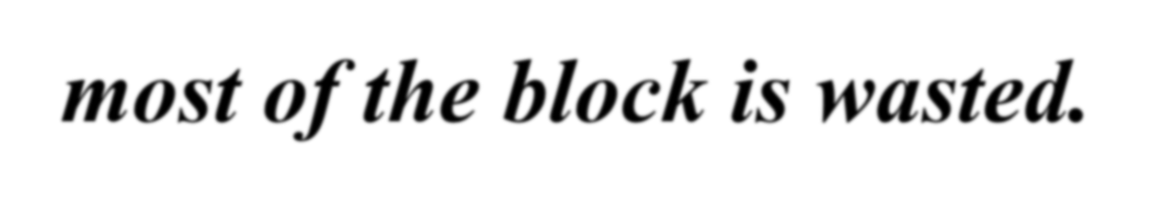

Slide 26

Network Addresses
The network address is the first address.
The network address defines the network to the rest of the Internet.
Given the network address, we can find the class of the address, the block, and the range of the addresses in the block

Slide 27
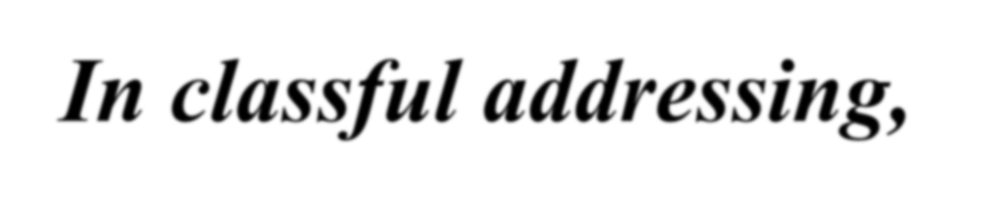

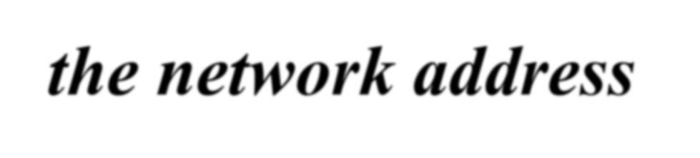
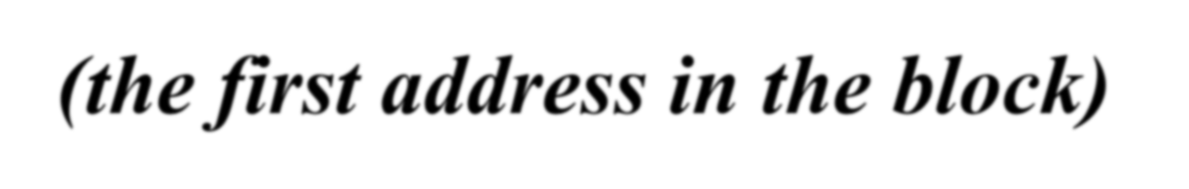
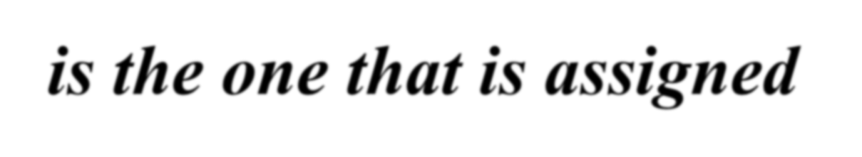
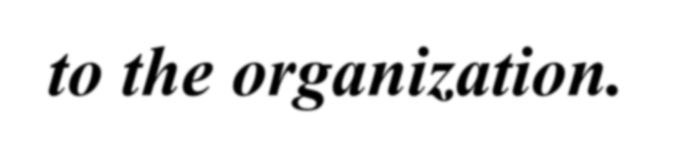

Slide 28
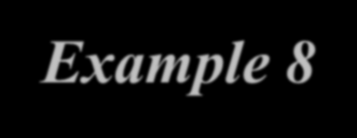


Example 8
Given the network address 132.21.0.0, find the class, the block, and the range of the addresses
Solution
The 1st byte is between 128 and 191.
Hence, Class B
The block has a netid of 132.21.
The addresses range from 132.21.0.0 to 132.21.255.255.

Slide 29
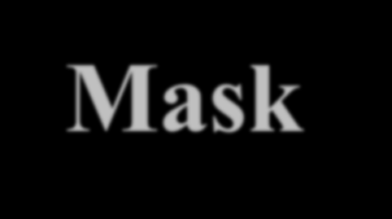
Mask
A mask is a 32-bit binary number.
The mask is ANDeD with IP address to get
The block address (Network address)
Mask And IP address = Block Address

Slide 30
Default Mask
Class A default mask is 255.0.0.0
Class B default mask is 255.255.0.0
Class C Default mask 255.255.255.0

Slide 31
Subnet Mask
An IP address has 2 parts:
The Network identification.
The Host identification.
Frequently, the Network & Host portions of the address need to be separately extracted.
In most cases, if you know the address class, it’s easy to separate the 2 portions.

Slide 32
Subnet Mask (Cont.)
With the rapid growth of the internet & the ever-increasing demand for new addresses, the standard address class structure has been expanded by borrowing bits from the Host portion to allow for more Networks.
Under this addressing scheme, called Subnetting, separating the Network & Host requires a special process called Subnet Masking.

Slide 33
Subnet Mask (Cont.)
The subnet masking process was developed to identify & extract the Network part of the address.
A subnet mask, which contains a binary bit pattern of ones & zeros, is applied to an address to determine whether the address is on the local Network.
If it is not, the process of routing it to an outside network begins.

Slide 34
Subnet Mask (Cont.)
The function of a subnet mask is to determine whether an IP address exists on the local network or whether it must be routed outside the local network.
It is applied to a message’s destination address to extract the network address.
If the extracted network address matches the local network ID, the destination is located on the local network.

Slide 35
Subnet Mask (Cont.)
However, if they don’t match, the message must be routed outside the local network.
The process used to apply the subnet mask involves Boolean Algebra to filter out non- matching bits to identify the network address.

Slide 36
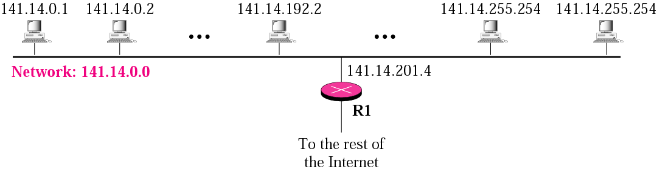
A network with two levels of hierarchy (not subnetted)

Slide 37
Note
Subnetting is done by borrowing bits from the host part and add them the network part

Slide 38
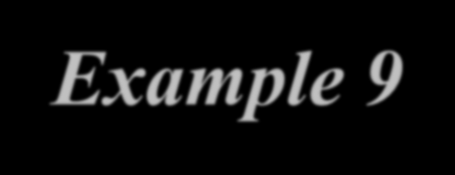
Example 9
What is the subnetwork address if the destination address is 200.45.34.56 and the subnet mask is 255.255.240.0?

Slide 39



Solution
AND OPERATION
11001000 00101101 00100010 00111000
11111111 11111111 11110000 00000000
11001000 00101101 00100000 00000000
The subnetwork address is 200.45.32.0.

Slide 40


What is the subnetwork address if the destination address is 19.30.80.5 and the mask is 255.255.192.0?
Example 10
Solution
See next slide

Slide 41


Solution

Slide 42

Comparison of a default mask and a subnet mask

Slide 43




Slide 44


A company is granted the site address
Example 11
201.70.64.0 (class C). The company needs six subnets. Design the subnets.
Solution
The number of 1s in the default mask is 24 (class C).

Slide 45

Solution (Continued)
The company needs six subnets. This number 6 is not a power of 2. The next number that is a power of 2 is 8 (2³). We need 3 more 1s in the subnet mask. The total number of 1s in the subnet mask is 27 (24 + 3).
The total number of 0s is 5 (32 − 27). The mask is

Slide 46

Solution (Continued)
11111111 11111111 11111111 11100000
or
255.255.255.224
The number of subnets is 8.
The number of addresses in each subnet is 2⁵ (5 is the number of 0s) or 32.

Slide 47

Example 3

Slide 48


A company is granted the site address
Example 12
181.56.0.0 (class B). The company needs 1000 subnets. Design the subnets.
Solution
The number of 1s in the default mask is 16 (class B).

Slide 49

Solution (Continued)
The company needs 1000 subnets. The number is not a power of 2. The next number that is a power of 2 is 1024 (2¹⁰). We need 10 more 1s in the subnet mask.
The total number of 1s in the subnet mask is 26 (16 + 10).
The total number of 0s is 6 (32 − 26).

Slide 50

Solution (Continued)
The mask is
11111111 11111111 11111111 11000000
or
255.255.255.192.
The number of subnets is 1024.
The number of addresses in each subnet is 2⁶ (6 is the number of 0s) or 64.

Slide 51

Example 4

Slide 52

Exercise
Let us consider an example of Class B network 172.16.0.0. What will be the first and last IP address, if we want to create 2 subnets

Slide 53

Exercise
Let us consider an example of Class B network 172.16.0.0. What is will be the first and last IP address, if we want to create 6 subnets

Slide 54
SUPERNETTING

Slide 55
What is supernetting?
Supernetting is the opposite of subnetting
In subnetting you borrow bits from the host part
Supernetting is done by borrowing bits from the network side.
And combine a group of networks into one large supernetwork.

Slide 56

A supernetwork

Slide 57
Rules:
❐ The number of blocks must be a power of 2 (1, 2, 4, 8, 16, . . .).
❐ The blocks must be contiguous in the address space (no gaps between the blocks).
❐ The third byte of the first address in the superblock must be evenly divisible by the number of blocks. In other words, if the number of blocks is N, the third byte must be divisible by N.

Slide 58

Which of the following set of class C blocks
Example 5
can be used to form a supernet for a company?
198.47.32.0 198.47.33.0 198.47.34.0
198.47.32.0 198.47.42.0 198.47.52.0 198.47.62.0
198.47.31.0 198.47.32.0 198.47.33.0 198.47.52.0
198.47.32.0 198.47.33.0 198.47.34.0 198.47.35.0

Slide 59

Solution
1: No, there are only three blocks.
2: No, the blocks are not contiguous.
3: No, 31 in the first block is not divisible by 4. 4: Yes, all three requirements are fulfilled.

Slide 60





Slide 61

In supernetting,
we need the first address of the supernet
and the supernet mask to define the range of addresses.

Slide 62

Comparison of subnet, default, and supernet masks

Slide 63

We need to make a supernetwork out of 16
class C blocks. What is the supernet mask?
Solution
We need 16 blocks. For 16 blocks we need to change four 1s to 0s in the default mask. So the mask is
11111111 11111111 11110000 00000000
or
255.255.240.0

Slide 64

Example 14
A supernet has a first address of 205.16.32.0 and a supernet mask of 255.255.248.0. A router receives three packets with the following destination addresses:
205.16.37.44
205.16.42.56
205.17.33.76
Which packet belongs to the supernet?

Slide 65

Solution
We apply the supernet mask to see if we can find the beginning address.
205.16.37.44 AND 255.255.248.0
205.16.42.56 AND 255.255.248.0
205.17.33.76 AND 255.255.248.0
➔ 205.16.32.0
➔ 205.16.40.0
➔ 205.17.32.0
Only the first address belongs to this supernet.

Slide 66

Example 15
A supernet has a first address of 205.16.32.0 and a supernet mask of 255.255.248.0. How many blocks are in this supernet and what is the range of addresses?
Solution
The supernet has 21 1s. The default mask has 24 1s. Since the difference is 3, there are 2³ or 8 blocks in this supernet. The blocks are 205.16.32.0 to 205.16.39.0. The first address is 205.16.32.0. The last address is 205.16.39.255.

